Slide 1


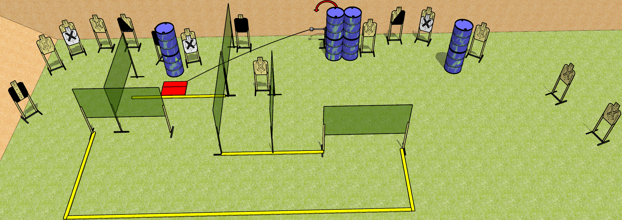
 | Dothan Gun Club – USPSA Match Who put that wall there??? Course Designer : Drew Coleman
START POSITION : Standing anywhere inside the shooting area. Hands relaxed at sides.
GUN READY CONDITION : Pistol loaded and holstered. PCC shouldered, safety on, pointed at a wall. |  | SCORING: Comstock, 32 rounds TARGETS: 16 paper, 0 Steel SCORED HITS: Best 2 on paper, steel until down START-STOP: Audible, last shot RULES:
STAGE PROCEDURE: Engage targets as they become available from within the fault lines

